Slide 1

Parallel Algorithms for Butterfly Computations
Group Members:
Ayaan Khan (22i-0832)
Ayaan Mughal (22i-0861)
Salar Shoaib (20-0830)

Slide 2

Introduction & Applications
Efficient Butterfly Counting
Key Technologies
Real-World Impact
Uses METIS for partitioning, MPI for distribution, OpenMP for threading.
Applications in social networks, recommendations, clustering, anomaly detection.
Focus on scalable parallel counting in bipartite graphs.

Slide 3
Understanding Butterfly Motifs
Bipartite Graphs
Butterfly Structure
Vertices split into two sets (L and R). Edges connect L to R only.
A 2x2 biclique: two L-side and two R-side vertices, all connected.
No edges within the same set
Represents dense local structure
Common in co-purchase, co-authorship data
Captures co-occurrence patterns

Slide 4




Motivation & Challenges
Why Butterflies?
Detect communities, spam, and co-occurrence patterns in networks.
Scale Issues
Graphs may have millions of vertices and edges.
Combinatorial Explosion
Sequential algorithms are too slow for large graphs.
Iterate over neighbor pairs (wedges)
Check shared connections for each wedge

Slide 5





PARBUTTERFLY: Solution Pipeline
Wedge Aggregation
Wedge Generation
Group wedges by endpoints to count shared neighbors.
Butterfly Counting
Form triplets centered at low-rank vertices.
Pairs of wedges with same endpoints form butterflies.
Vertex Ranking
Peeling (Optional)
Assign rank by degree or degeneracy order.
3
k-tip/k-wing decomposition by butterfly participation.
2
4
1
5

Slide 6
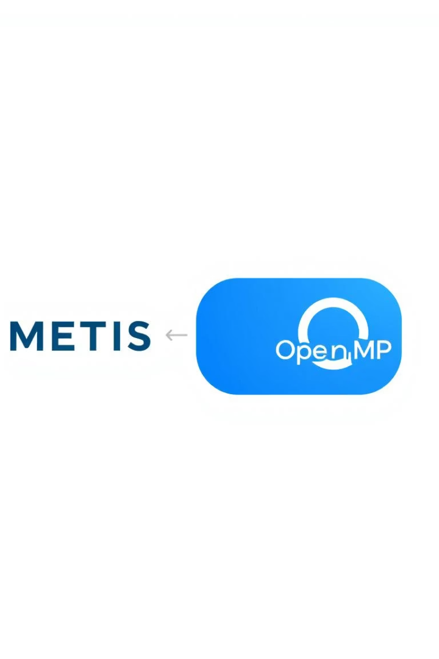
Tools & Parallel Strategy
METIS
MPI
Partitions the graph into balanced subgraphs for parallel processing.
Distributes partitions across processes for inter-node parallelism.
OpenMP
Enables intra-node parallelism for wedge generation and aggregation.

Slide 7
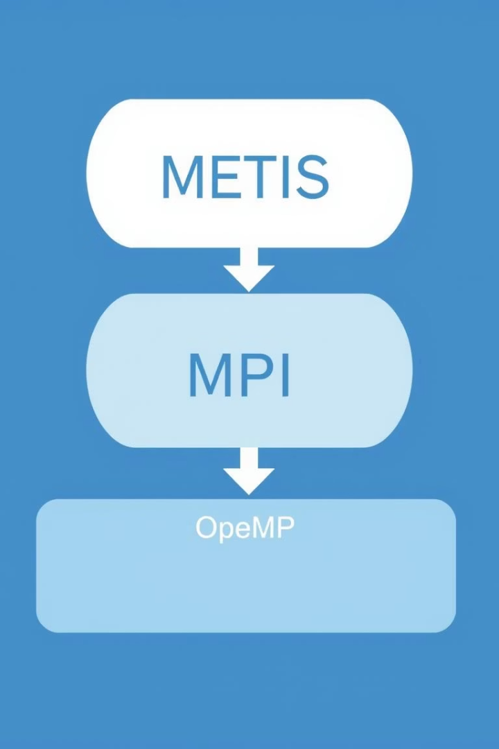




System Architecture
METIS Partitioning
Divides the graph into balanced parts.
MPI Processes
Each process handles a partition for distributed computation.
OpenMP Threads
Local butterfly counting within each process.
MPI Reduce
Combines local results into a global butterfly count.

Slide 8

Parallelization Details
1
METIS Partitioning
Minimizes edge cuts, balances workload before MPI.
2
MPI Distribution
Each process receives a partition, exchanges boundary data, computes local counts.
3
OpenMP Computation
Parallelizes wedge generation and aggregation using atomic updates or buffers.

Slide 9
Algorithm Implementation Steps
Partition Graph
Use METIS for balanced subgraphs.
Distribute with MPI
Load partitions into MPI ranks.
Local Computation
Rank vertices, generate and aggregate wedges, count butterflies.
OpenMP Parallelism
Enumerate and aggregate wedges in parallel.
Result Gathering
Merge results with MPI_Reduce.

Slide 10

Benefits & Scalability
—
Speedup
Significant speedup over sequential baseline.
—
MPI Overhead
Minimal overhead due to METIS partitioning.
—
Vertices
Handles graphs with millions of vertices and edges.
∞
Scalability
Strong scaling as nodes increase, foundation for advanced mining.

